Slide 1
AIR POLLUTION
CAUSES AND REMEDIES

Slide 2
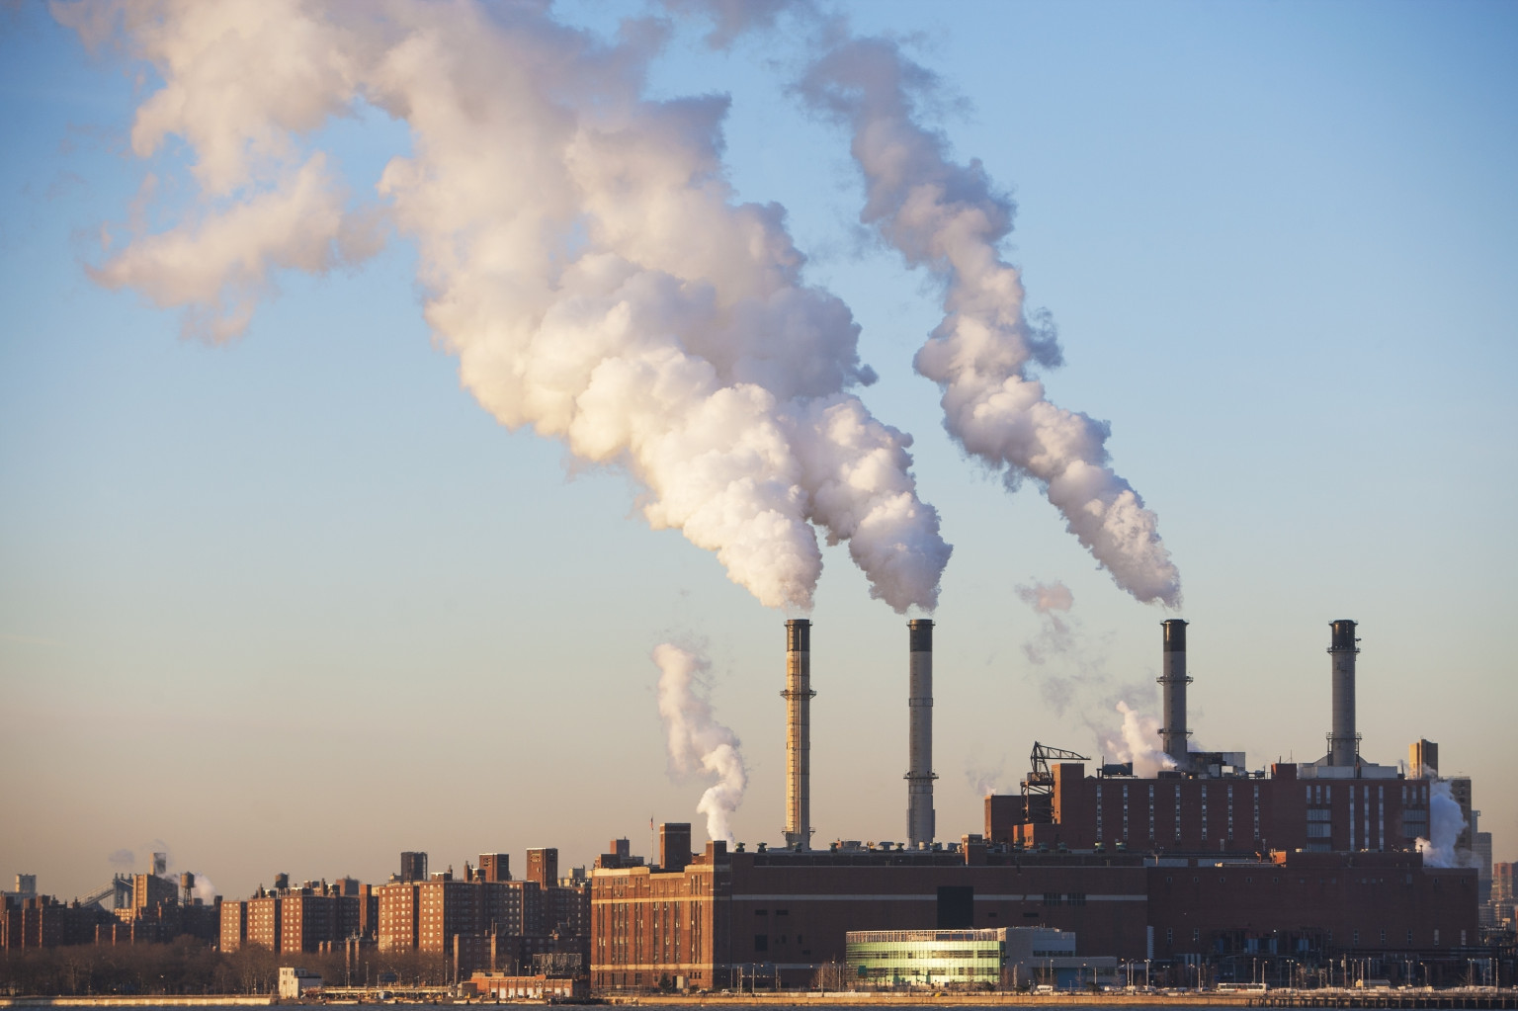

Slide 3
Air pollution is the contamination of air due to the presence of substances in the atmosphere that are harmful to the health of humans and other living beings.
Air pollution can cause diseases, allergies, and even death to humans; it can also cause harm to other living organisms such as animals and food crops, and Air pollution can be caused by both human activities and natural phenomena.

Slide 4
Causes Of Air Pollution – Various Causes
Besides anthropogenic factors, there are other factors which are considered as natural – such as volcanic eruptions and forest fires. Though these are rather sporadic, they can pump large amounts of greenhouse gases into the atmosphere. These gases can block out the sunlight, plunging the world into an ice age; or trap the heat from the sun, causing global warming. Following are some of the major causes of air pollution – anthropogenic and natural factors are included:
Burning of fossil fuels:
Combustion of fossil fuels pumps out a lot of greenhouse gases. Vehicles are one of the biggest sources of carbon emissions. Moreover, most industries also rely on fossil fuels to power their machinery.
Agricultural activities
Ammonia is one of the most common by-products of agricultural activities. It is also extremely toxic if inhaled.
Mining operations
Mining operations are one of the major culprits of air pollution. Toxic substances are released during the operations that may negatively affect the health of the workers and the people that live nearby.
Indoor Air pollution

Slide 5
Effects of Air Pollution
Air pollution affects all things. It is harmful to our health, and it impacts the environment by reducing visibility and blocking sunlight, causing acid rain, and harming forests, wildlife, and agriculture. Greenhouse gas pollution, the cause of climate change, affects the entire planet.
According to theWORLD HEALTH ORGANIZATION, an estimated seven million people die each year from air pollution. More than 4,000 people to breathe. Exposure to high ozone levels can cause sore throat, coughing, lung inflammation, and permanent lung damage.

Slide 6
Remedies for air pollution

Slide 7
1. Using public transports
Using public transport is a sure short way of contributing to less air pollution as it provides with less gas and energy, even carpools contribute to it. In addition to less release of fuels and gas, using a public transport can also help in saving money.1
2. Turn off the lights when not in use
The energy that the lights take also contribute to air pollution, thus less consumption of electricity can save energy. Use energy saving fluorescent lights to help the environment.
3. Recycle and Reuse
The concept of recycle and reuse is not just conserve resources and use them judicially but also is helpful for air pollution as it helps in reducing pollution emissions. The recycled products also take less power to make other products.

Slide 8
5. Reduction of forest fires and smoking
The collecting of garbage and getting it on fire in dry seasons or dry leaves catching fires is a huge factor for causing air pollution, moreover smoking also causes air pollution and causes the air quality to worsen along with obviously damaging one’s health.
6. Use of fans instead of Air Conditioner
The usage of AC’s takes a lot of energy and emits a lot of heat which is bad for the environment. AC’s also take a lot of power and energy to work as compared to fans.
7. Use filters for chimneys
The gas that is emitted from fireplaces in homes and factories are extremely dangerous for air pollution and harms the air quality severely. The use of filters should be used at least if the consumption couldn’t be lessened, this will help to reduce the effect of harmful gases absorbing in the air.

Slide 9
8. Avoid usage of crackers
The use of crackers during festivals and weddings is sadly one of the biggest contributors to air pollution, leading to a layer of smog which is extremely harmful for health. So, practice of no crackers should be implemented.
9. Avoid using of products with chemicals
Products that use the chemicals in their usage or smell strongly, like paints or perfumes should be used less or outside the house. There can also be an alternative to use products with low chemical content and organic properties.
10. Implement Afforestation
Last but not the least, plant and grow as many trees as possible. The practice of planting trees provides a lot of benefits to the environment and helps with the release of oxygen.

